Slide 1
Car accident detection
Using deep learning for image classification
By: Goulmemei BASSIME AMRAM

Slide 2
Project Overview
Objective: Develop a deep learning model to classify images of cars into 'accidented' and 'nonaccident' categories.
Method: Use Convolutional Neural Networks (CNNs) for image classification.

Slide 3


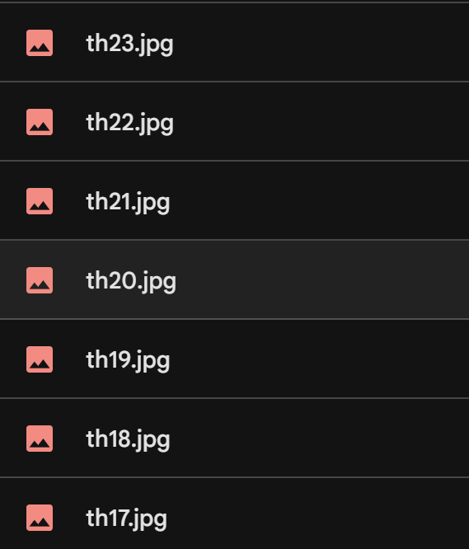
DATASET Description
Images are preprocessed to a standard size and normalized.

Slide 4
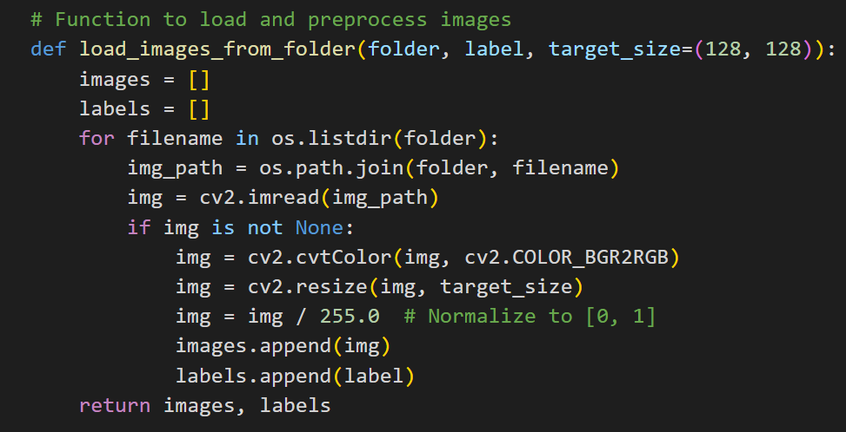
Data processing
Resize images to 128x128 pixels.
Normalize pixel values to the range [0, 1].
Example code snippet for preprocessing

Slide 5
Model architecture
Convolutional Neural Network (CNN)

Slide 6
Model trainning
Data augmentation techniques used:
Rotation
Width shift
Height shift
Horizontal flip
Split dataset into training and testing sets.
Train the model using the training data.
Evaluate the model using the testing data.
Save the trained model for future use.

Slide 7

Model evaluation
Metrics used: Accuracy, Loss
Example evaluation results:
Training accuracy: 95%
Testing accuracy: 90%

Slide 8
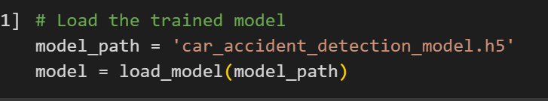
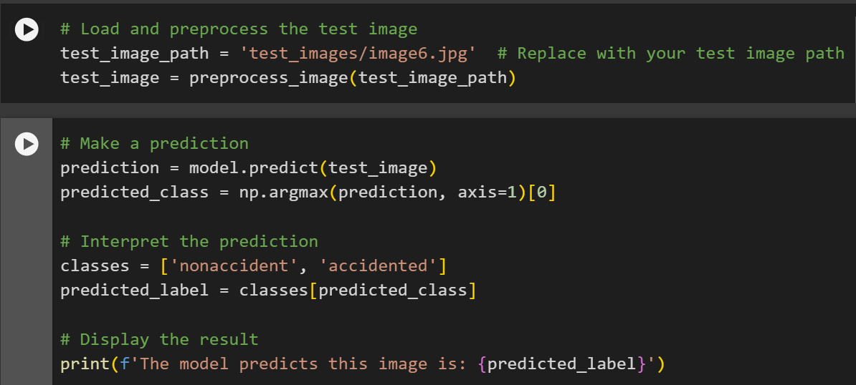
usage
Steps to use the trained model for predictions:
Load the model.
Preprocess the image.
Make a prediction.
Interpret the prediction.

Slide 9
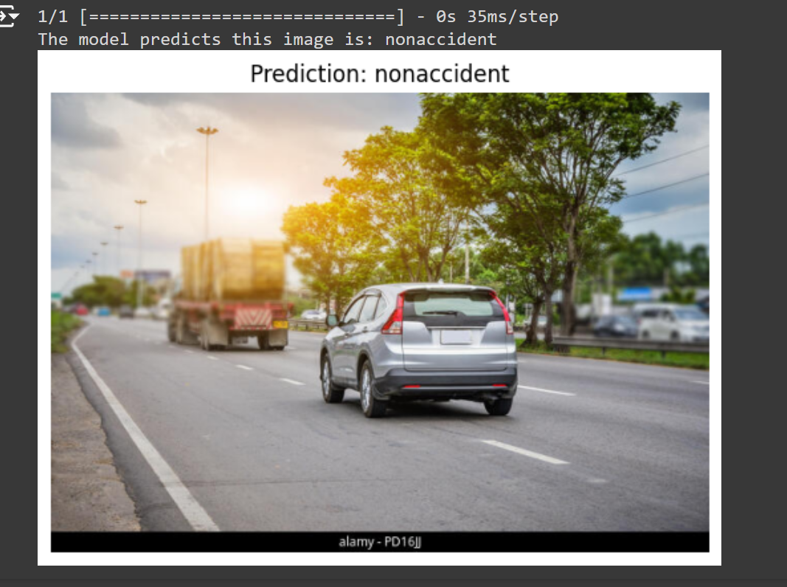
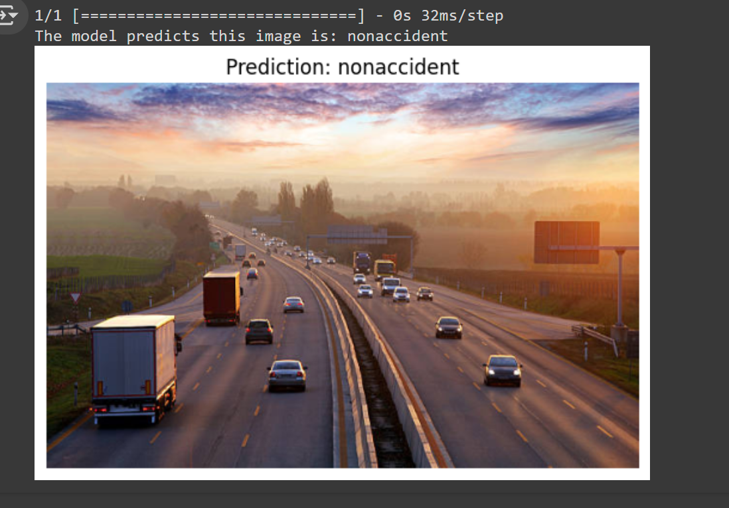
RESULTS

Slide 10
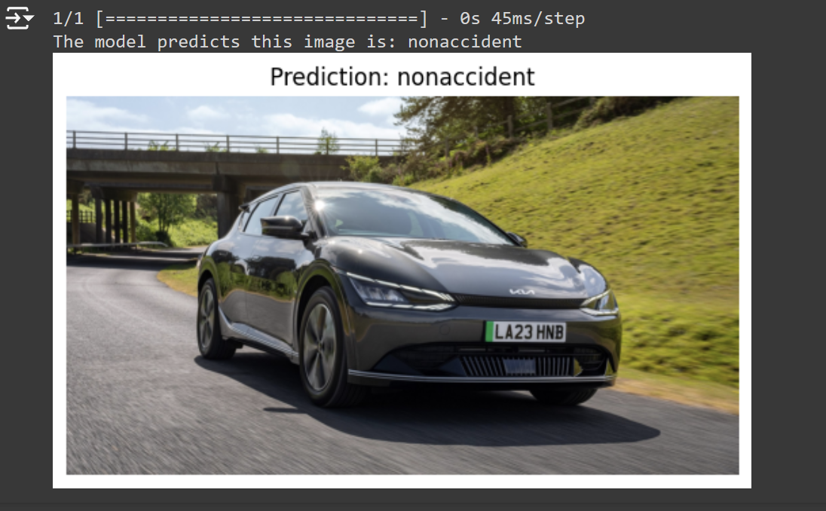
RESULTS

Slide 11
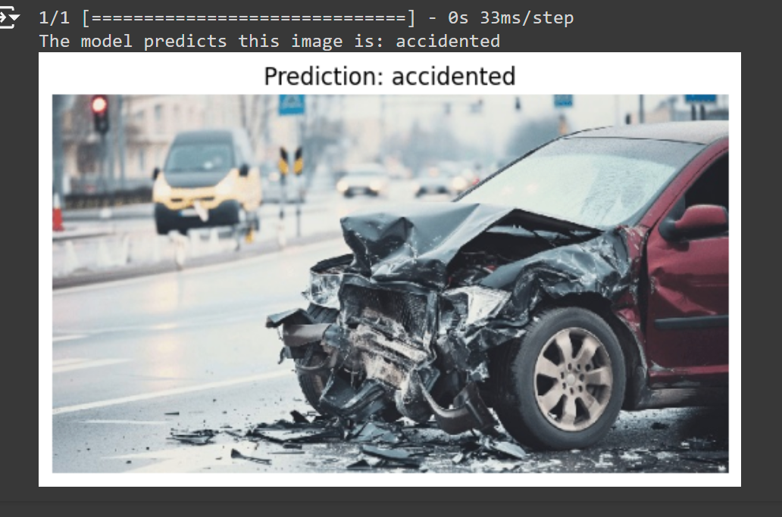
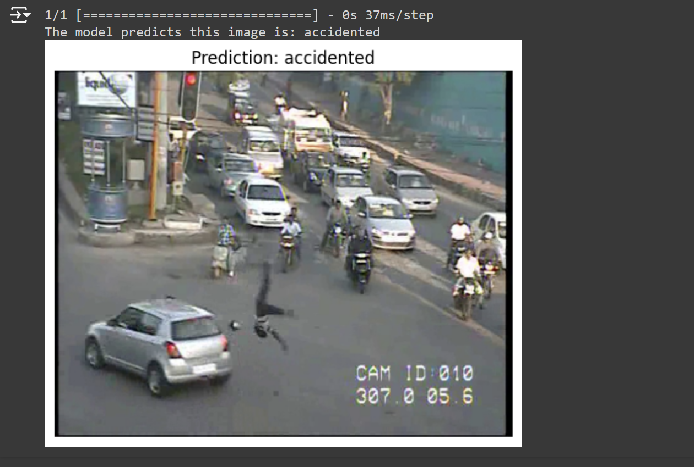
RESULTS

Slide 12
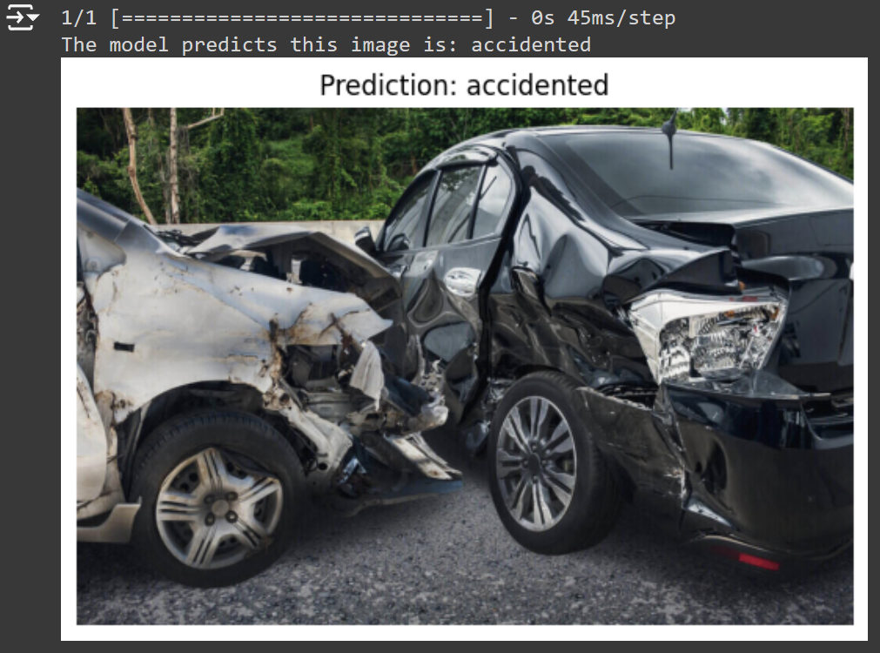
Results

Slide 13
Conclusion
Summary of the project.
Model can accurately classify car accident images.
Importance of data quality and preprocessing.
Source code and dataset available at :
"https://github.com/Amrampro/AI-car-accident-detection.git"

Slide 14
Q&A

